Slide 1
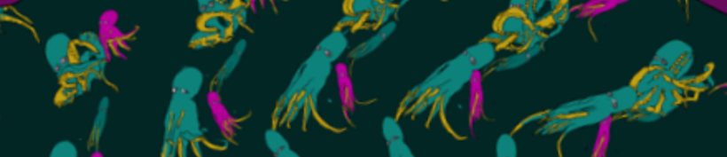
Ultra-Hi Definition Real Time Zoetrope
Nomso Ashiogwu, Daniel Cleaver, Mick Harrigan, Christian Lostoski
Notes:
Nomso

Slide 2
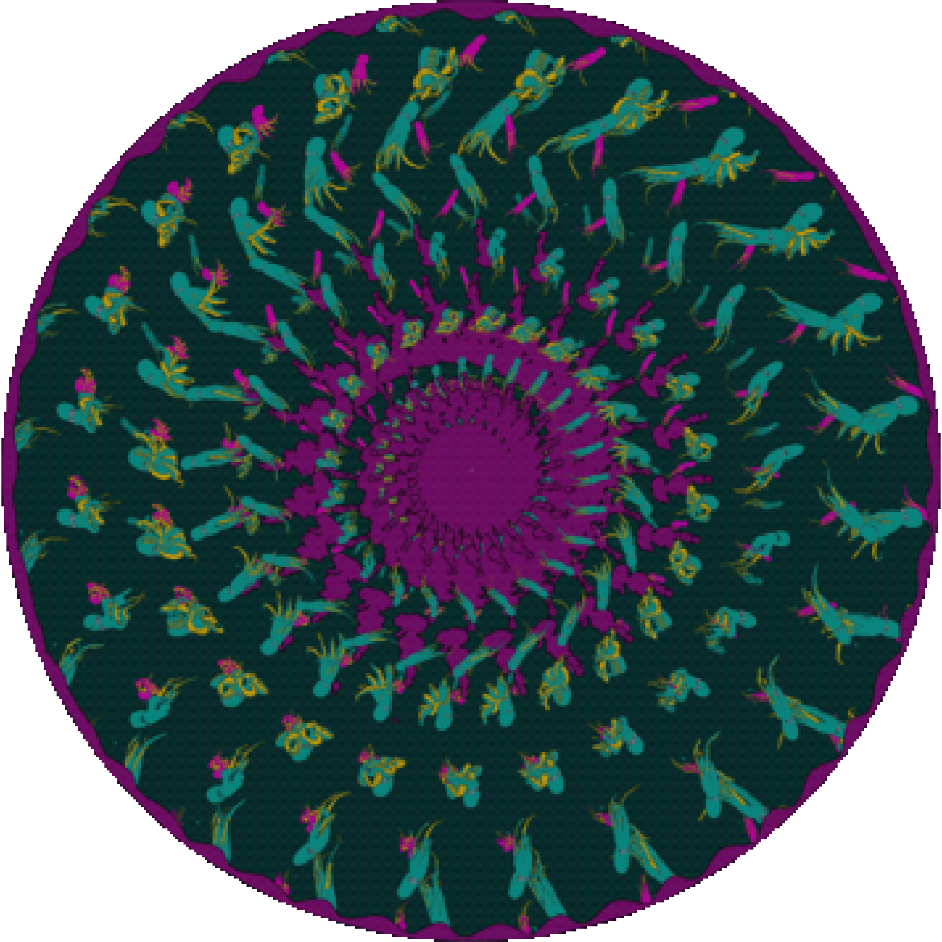
Project Introduction
Interactive art installation
User controller rotation and animation of a static image
Direction dependent on the users actions
Music tied to direction and speed of rotation
Notes:
Nomso

Slide 3
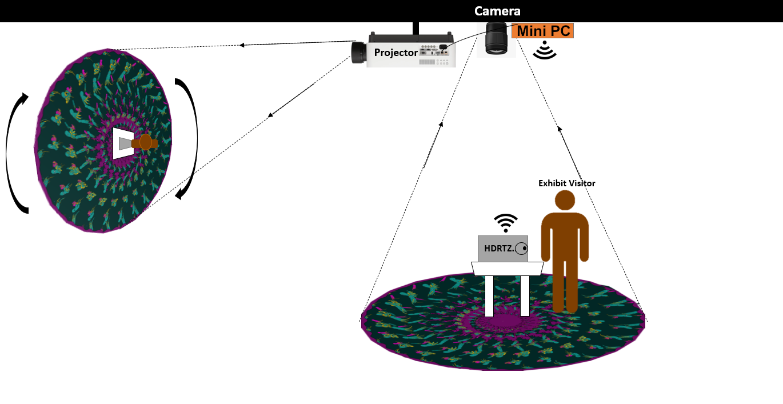
Operational Scenario
Notes:
Christian

Slide 4
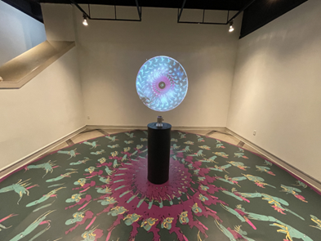
Operational Scenario
Notes:
Christian

Slide 5
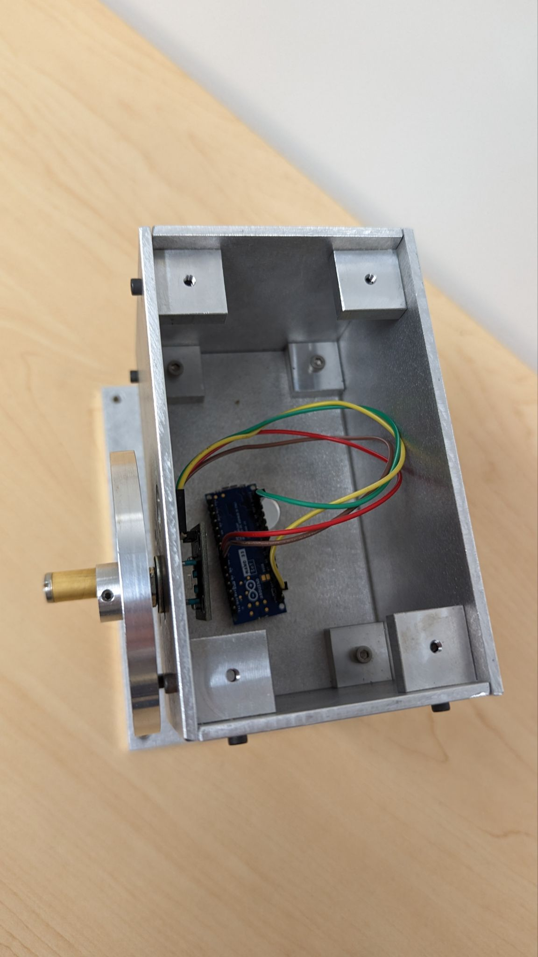
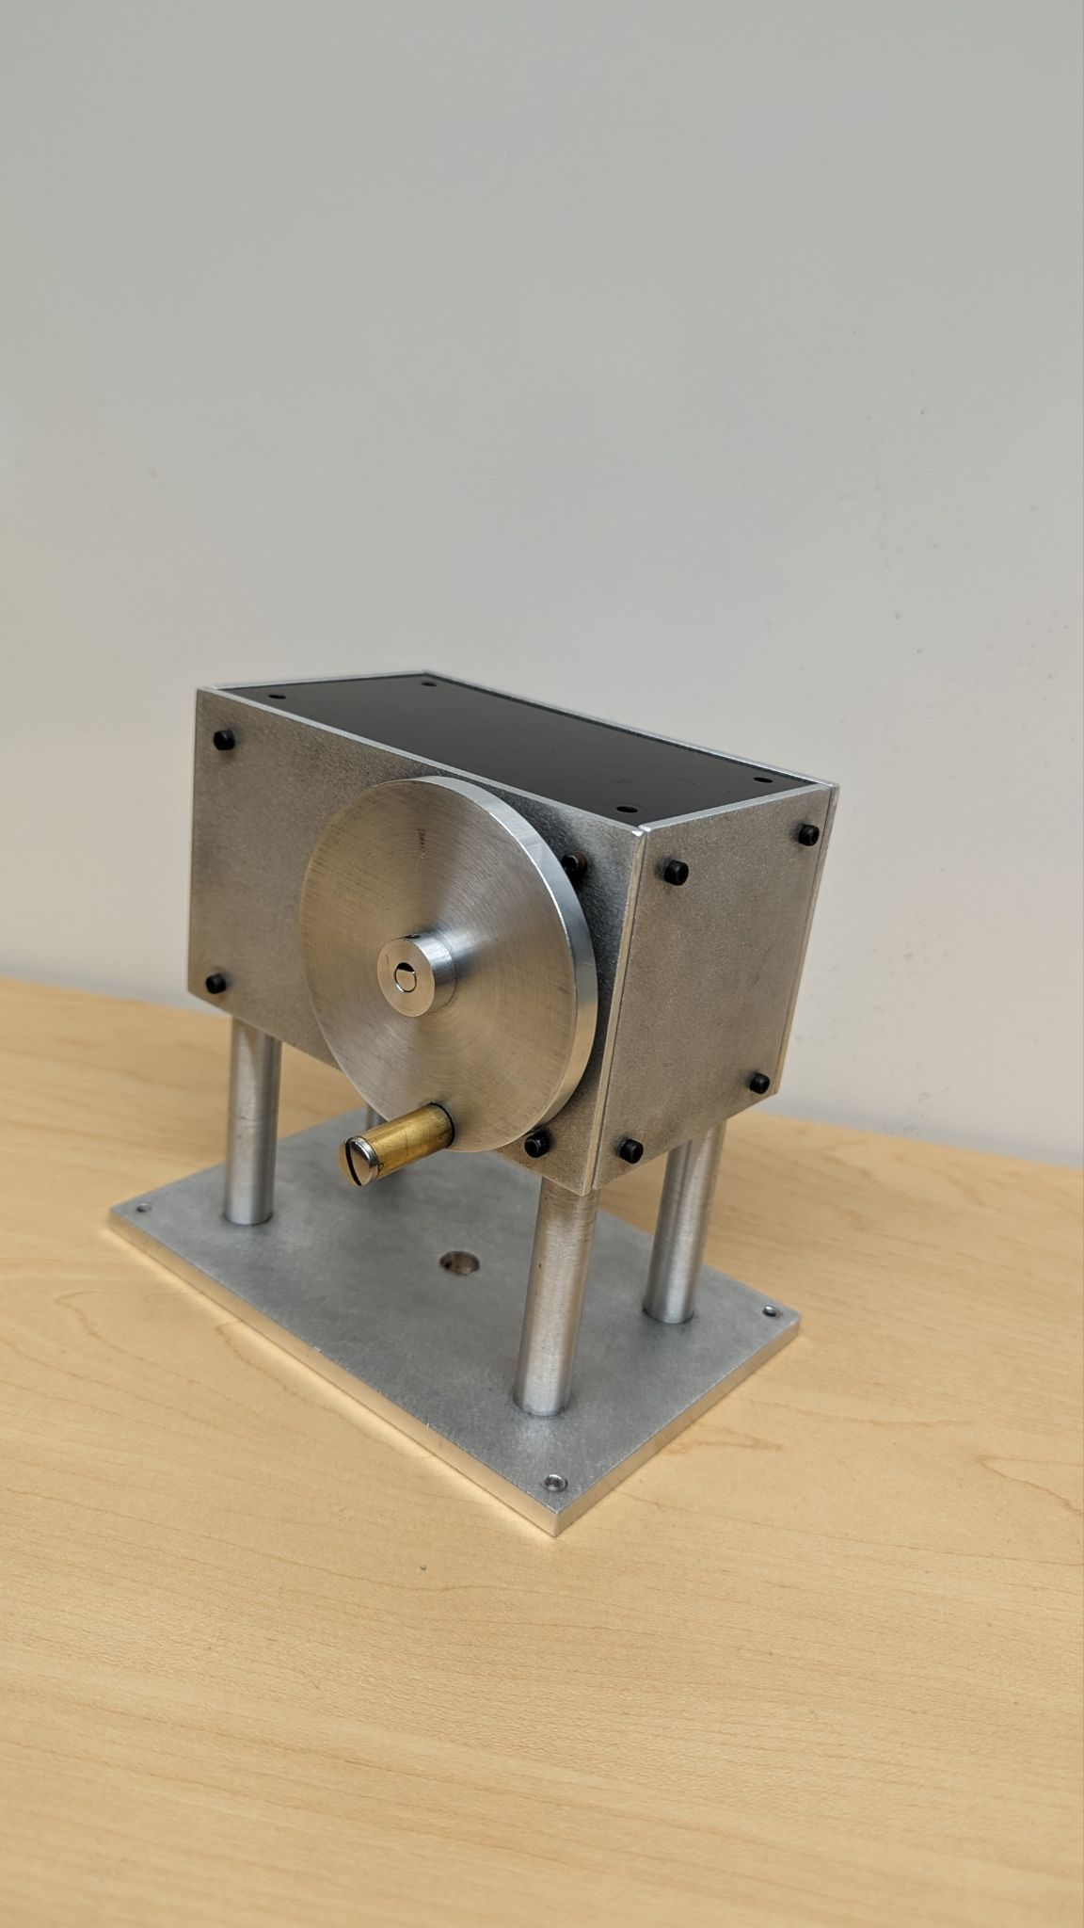
Hardware Description
Crank Setup
Rotary Encoder to Arduino
Notes:
Christian - Mention Plans for DC motor

Slide 6
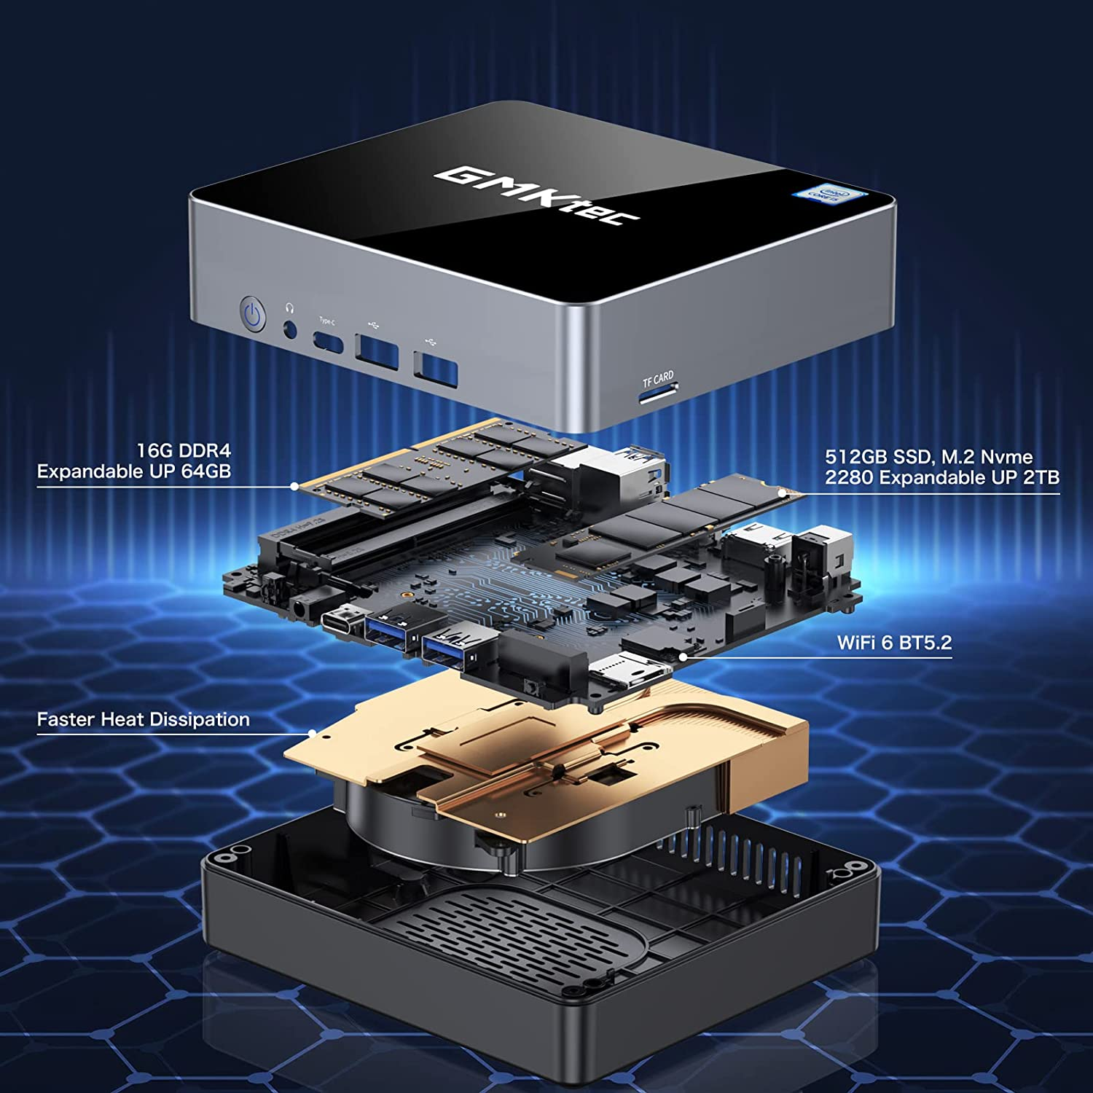
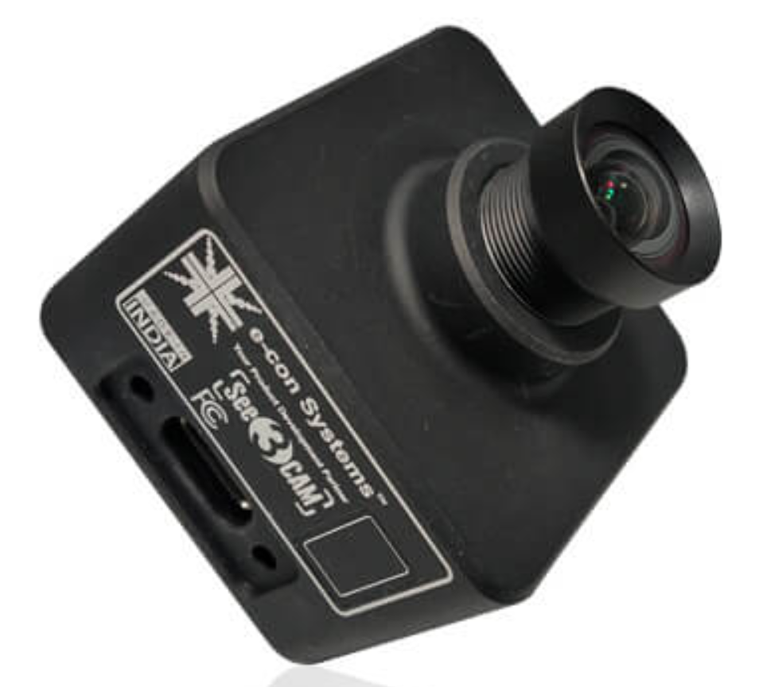
Hardware Description
4k USB-C Camera
Mini PC
Notes:
Chrisitan

Slide 7
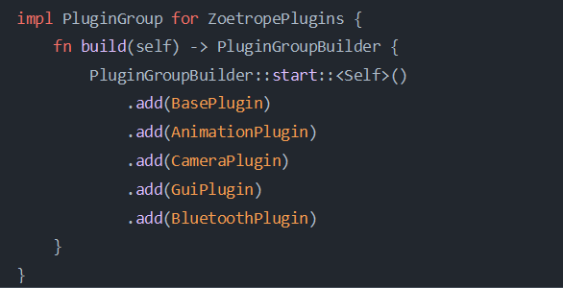
Software Description
C++ to Rust Conversion
SDL to Bevy
Hardware Requirement changes
Modularization of Systems
Built-in examples of functionality
Notes:
mick

Slide 8
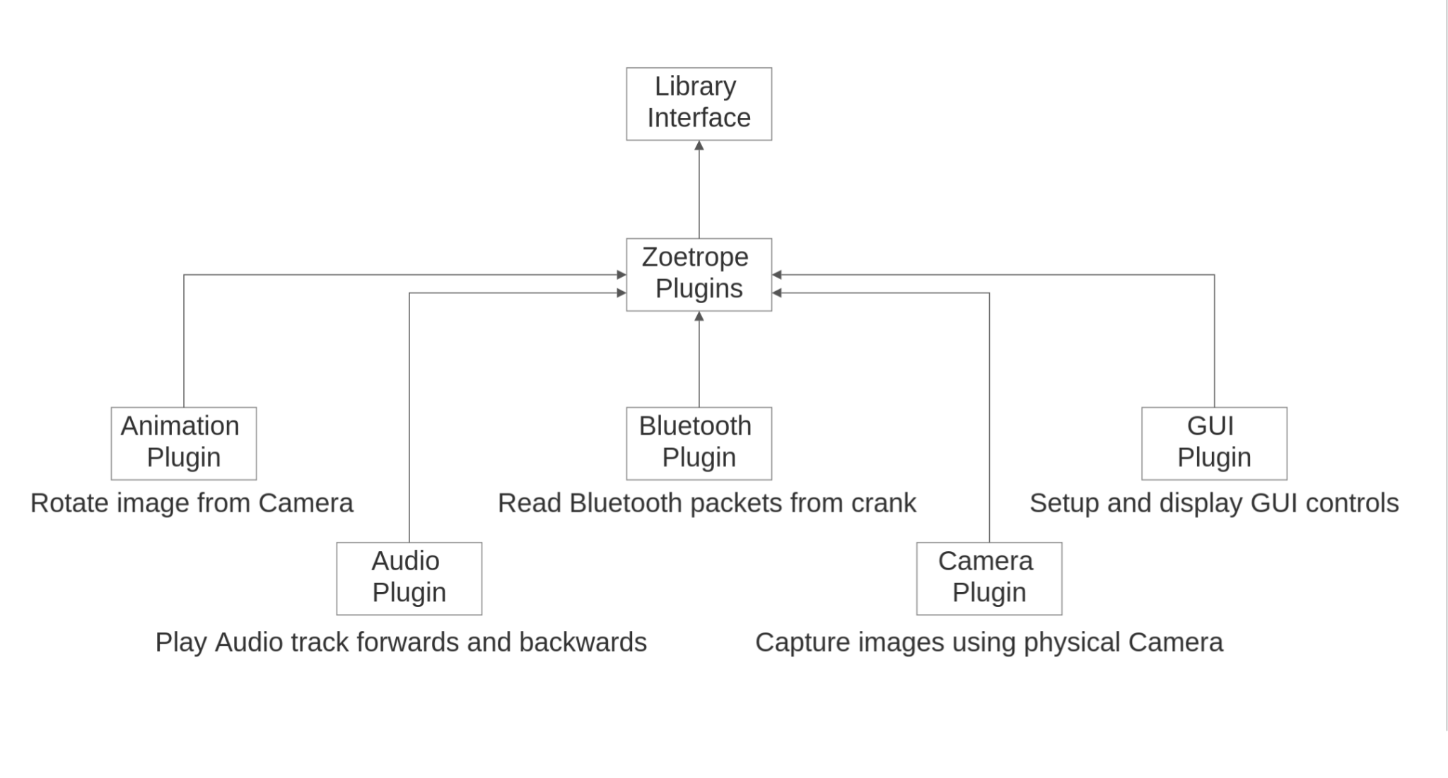
Software Description Cont.
Notes:
mick

Slide 9
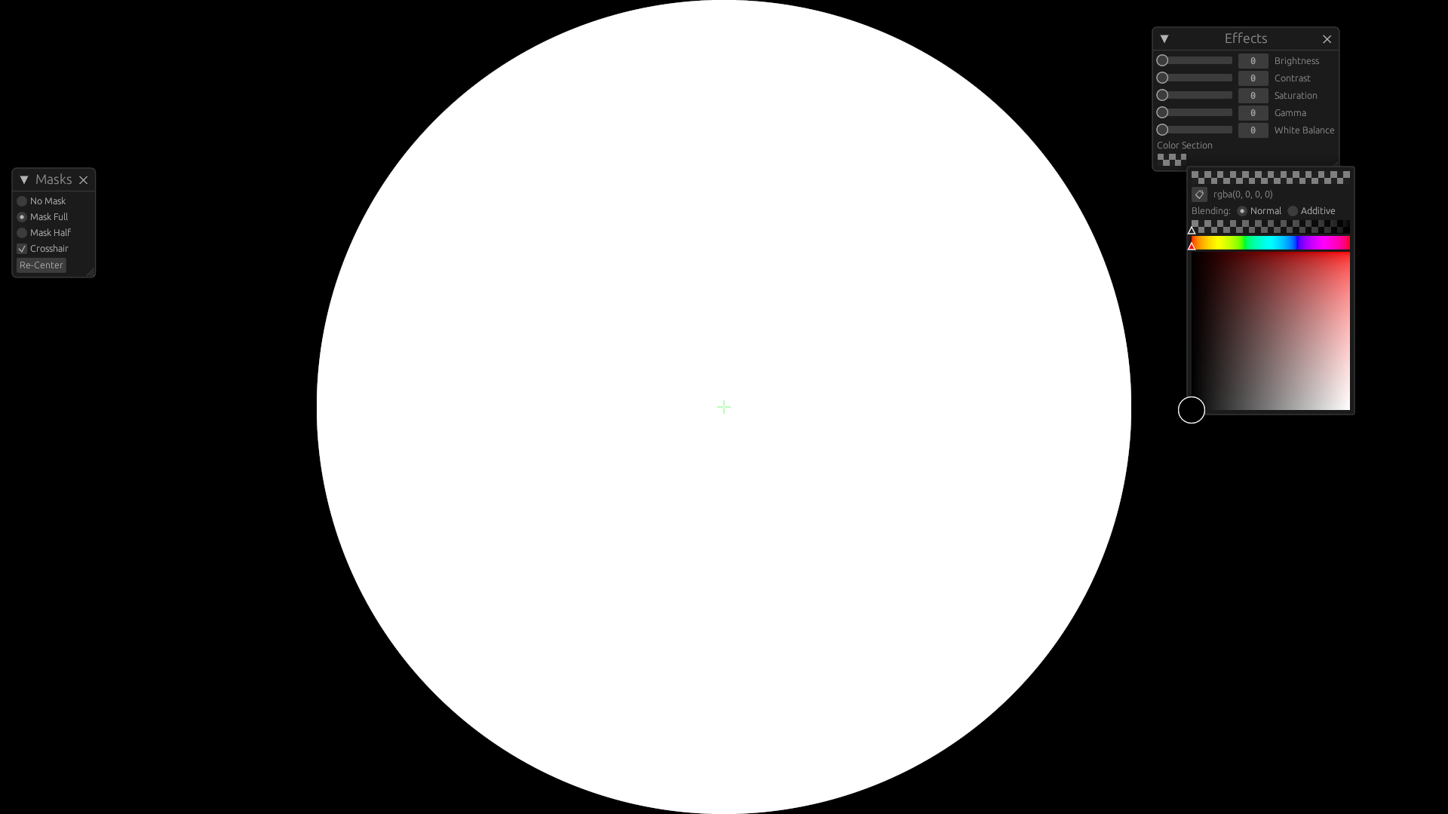
User Interface
Notes:
Mick - Mention Arrow Keys

Slide 10
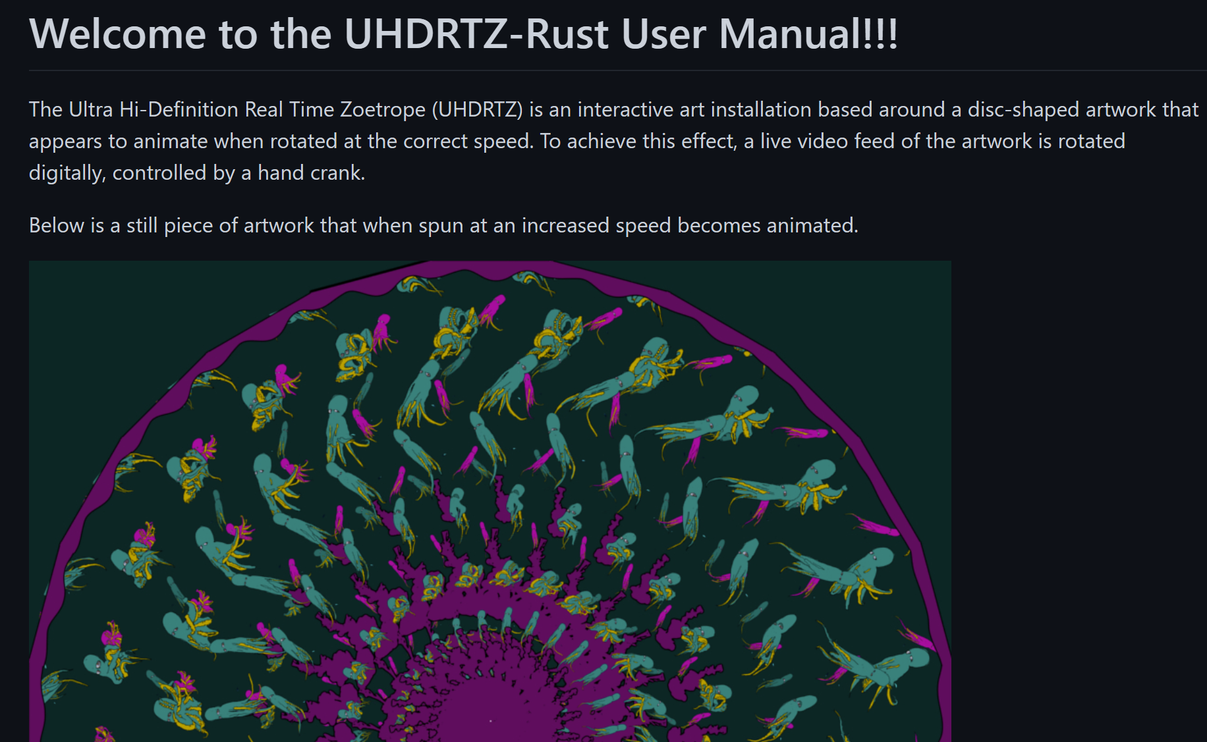
User Guide
Created a user manual for people to use in the future
Currently adding the functions of the hardware and software
Displays the details of the project and how it works
Notes:
nomso

Slide 11
Preliminary Testing
Image Rotation
Correct speed and framerate
Debug image rotation with keyboard input
Zoom, toggle masks
Audio plays
Notes:
dan

Slide 12
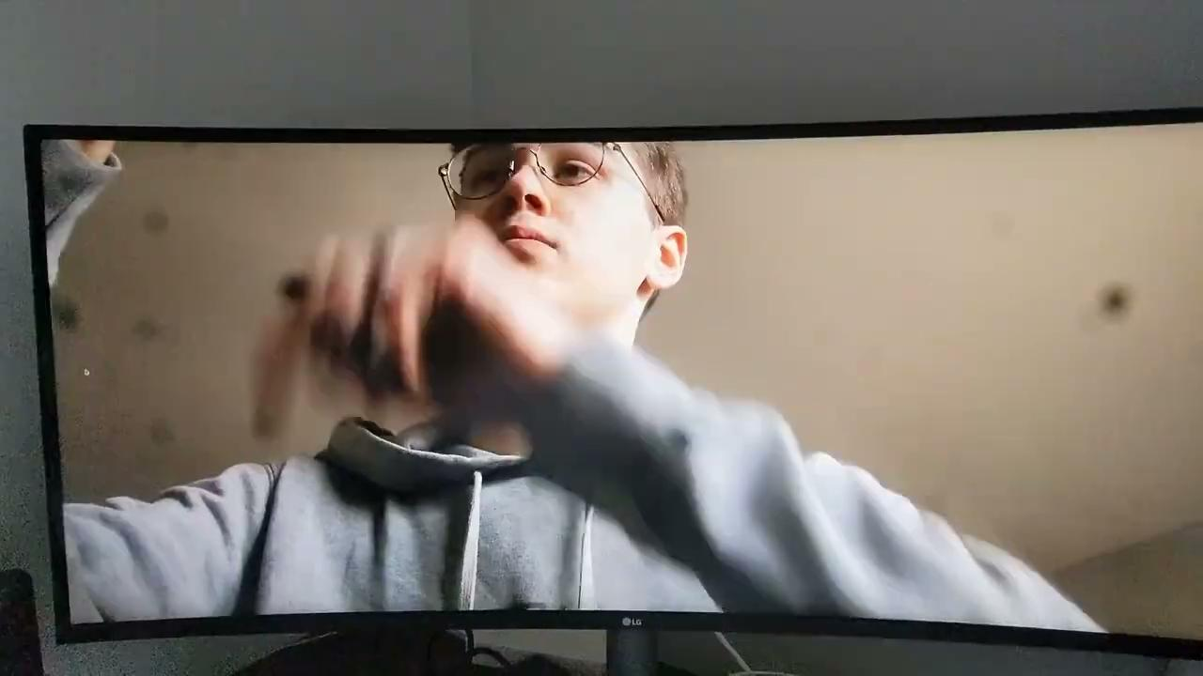
Testing Video
Notes:
dan

Slide 13
SRS Compliance
Speed of rotation (2.2.2)
Speed of rotation and framerate are two different numbers
FPGA (2.3.4 and throughout)
Replaced with Mini PC
Haptic feedback using DC motor (unwritten/planned)
Questionable
Run on boot (unwritten/planned)
Abandoned, replaced with other options
Notes:
dan

Slide 14
What’s Left?
Make quality of life improvements to software
Implement camera FX to replace the Effects Box
Test the full system
Write User Guide
Write SDD
Notes:
dan

Slide 15
Questions?
Thank you for your time
Notes:
dan

